Slide 1
D365FO, Git, and ALM: How to Deliver More Faster

Slide 2


Slide 3
Who Am I?
Nathan Clouse
Technical Architect
enVista Corp.
Microsoft Business Applications MVP (3x)
nclouse@envistacorp.com
www.atomicax.com
www.dynamics.fo
@NathanClouseAX

Slide 4

Agenda
Azure DevOps
Process Templates and How to make DevOps work for you. It’s not dead after all.
GitHub
Talk through what GitHub can and can’t do.
Source Control Options and Configurations
Talk through configurations and options to make DevOps do what you want, when you want.
Branching
Discuss different branching strategies along with what works and what doesn’t.
Pipelines
Build, Test, Deploy. Turn DevOps into a “One-Man Army”.

Slide 5

Prerequisites
Before We Start Journey
Access to Dev environment (local VS will work for some items)
Access to DevOps instance as an administrator
Access to LCS Project

Slide 6
Activity 1
Have the attendees introduce themselves and share their experience level with Git, Azure DevOps, and X++. List 1 thing you want to learn more about.

Slide 7

Basics – What is LCS
Life Cycle Services
Manager / Monitor Environments
SQL Insights (amongst other SQL monitoring tools)
Various Health metrics
Manages various assets
Build or Release Pipeline
Visual Studio, Create Package
Asset Library (packages, databases)
Don’t do this

Slide 8
Azure DevOps Process Templates

Slide 9
Process Templates
Agile
Scrum
CMMI
an iterative and incremental approach to project management, often used in software development, that focuses on delivering high-quality, working software quickly and frequently.
Scrum is based on the Agile methodology, which emphasizes flexibility, customer satisfaction, and rapid delivery of working software
process improvement that helps organizations improve their processes and performance in a structured and systematic way.

Slide 10
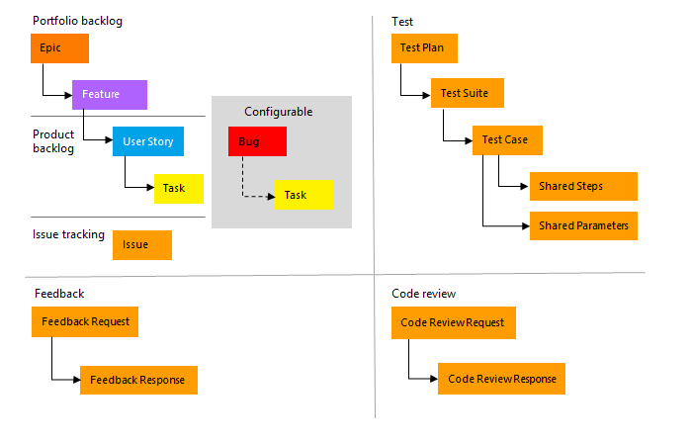

Slide 13
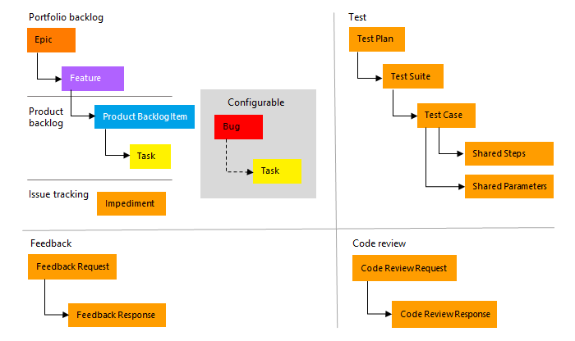

Slide 16
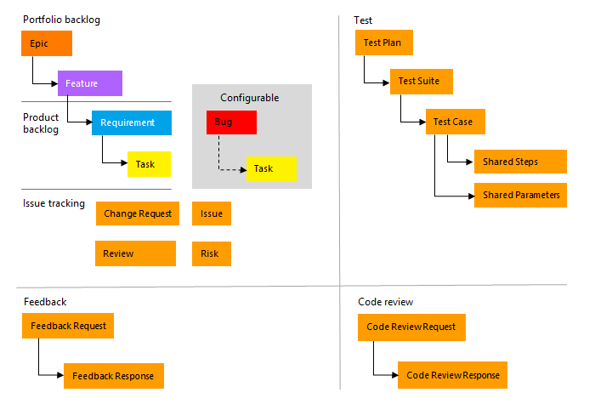

Slide 17
What about GitHub?
What Works?
What Doesn’t work?
What about Nuget Packages?
Rapidly Changing
Most everything works in GitHub vs DevOps in terms of Git source control
Pipelines are different syntactically and have different service offerings. How can we build without the DevOps Add-in for F&O?
F&O NuGet Packages not publicly available. Have to use something for a private solution Like Azure (DevOps) Artifacts or GitHub Packages
MSFT has interest in adding documentation for end users and partners in this area. We’re going to see more stuff this year.

Slide 18
Source Control Options

Slide 19
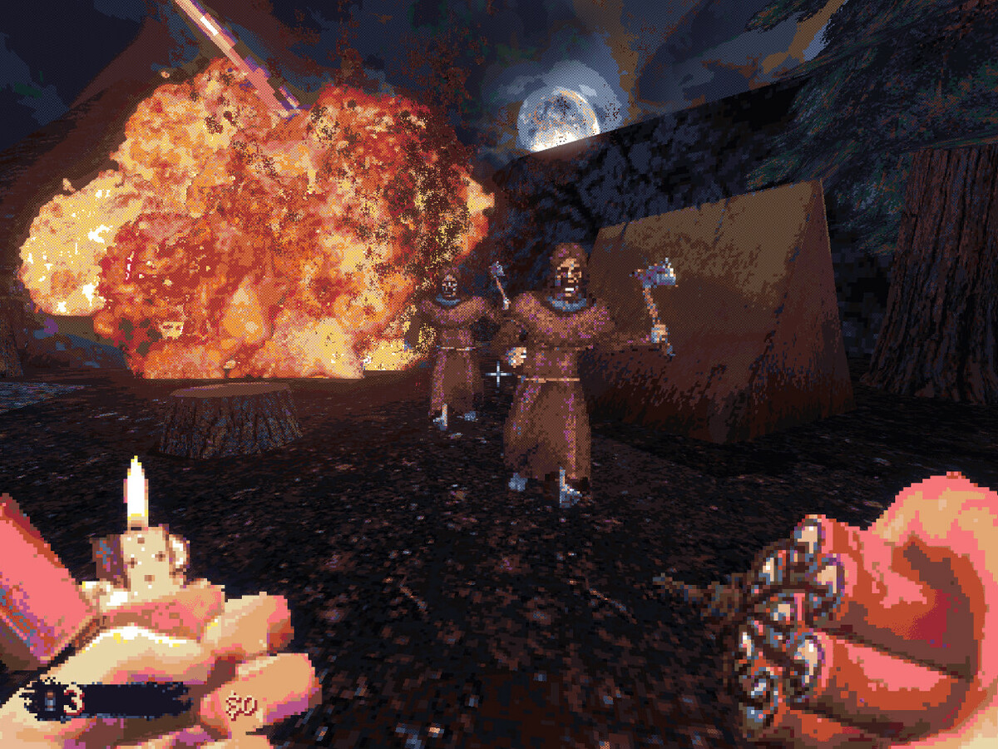
What is Git?
The Future
Git is a distributed version control system, which allows multiple developers to work on the same codebase and track changes to the code.

Slide 20
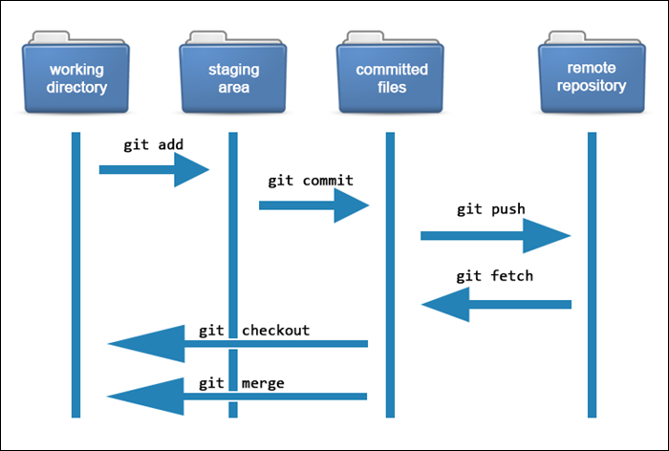

Slide 23
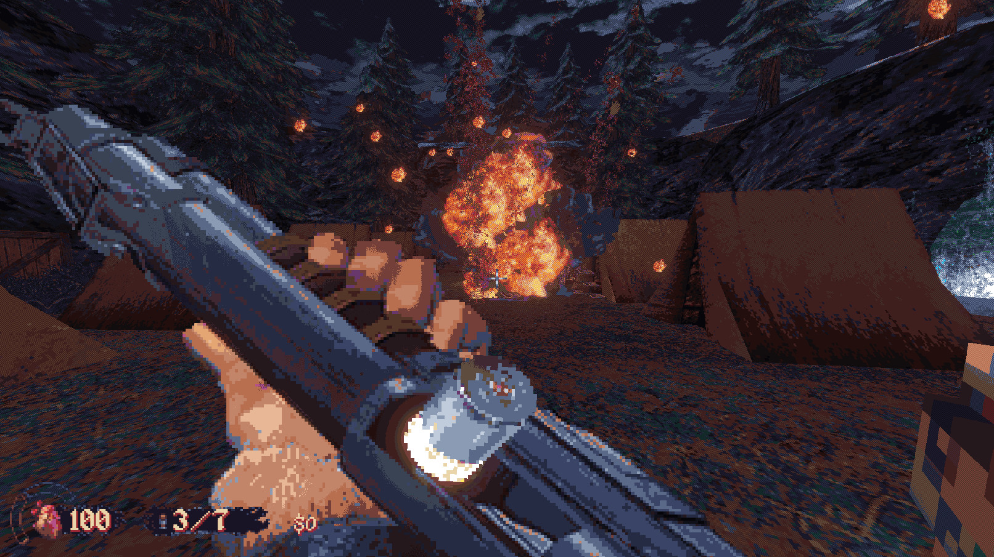
What are Azure Repos
Part of Azure DevOps
Azure Repos is a cloud-based source code management tool that is part of Azure DevOps. It provides Git repositories for version control, as well as a web-based interface for collaboration, code reviews, and project management. Azure Repos supports both Git and Team Foundation Version Control (TFVC) for version control.

Slide 24
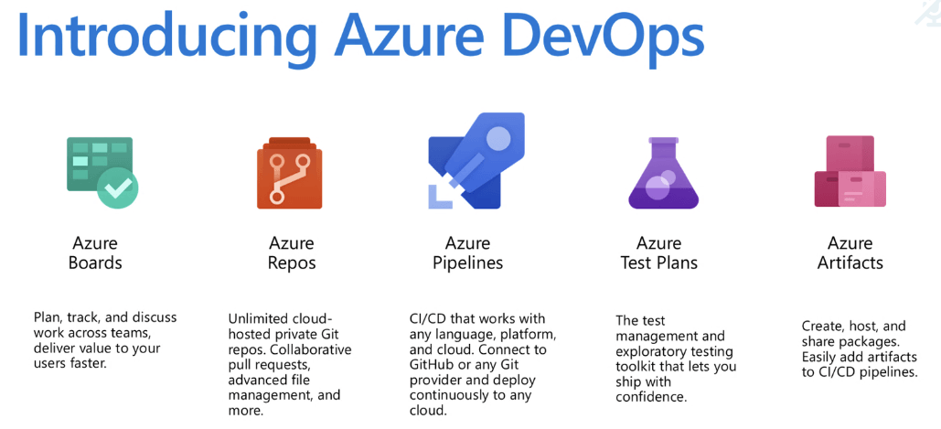

Slide 26
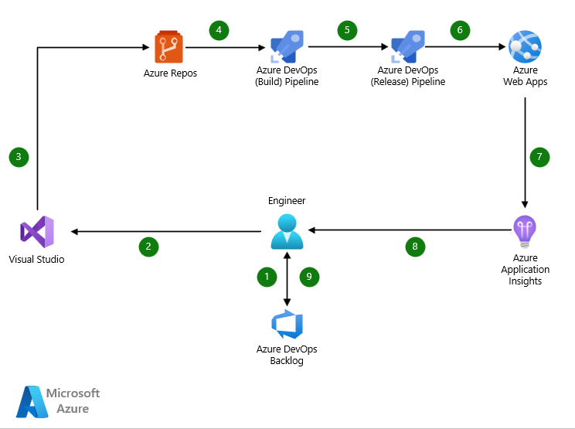

Slide 28
Git In Azure Devops
Pull Requests
Code Reviews
Continuous Integration
Continuous Deployment
Requests that a branch be merged into another branch. In Git, we merge branches, not changesets
As part of a Pull Request (PR), code gets reviewed, feedback is provided, PRs can be declined
More opportunity to interact with changes throughout the process. Build and test changes automagically based on activity of developers
Build, Test, Package, Ship

Slide 29
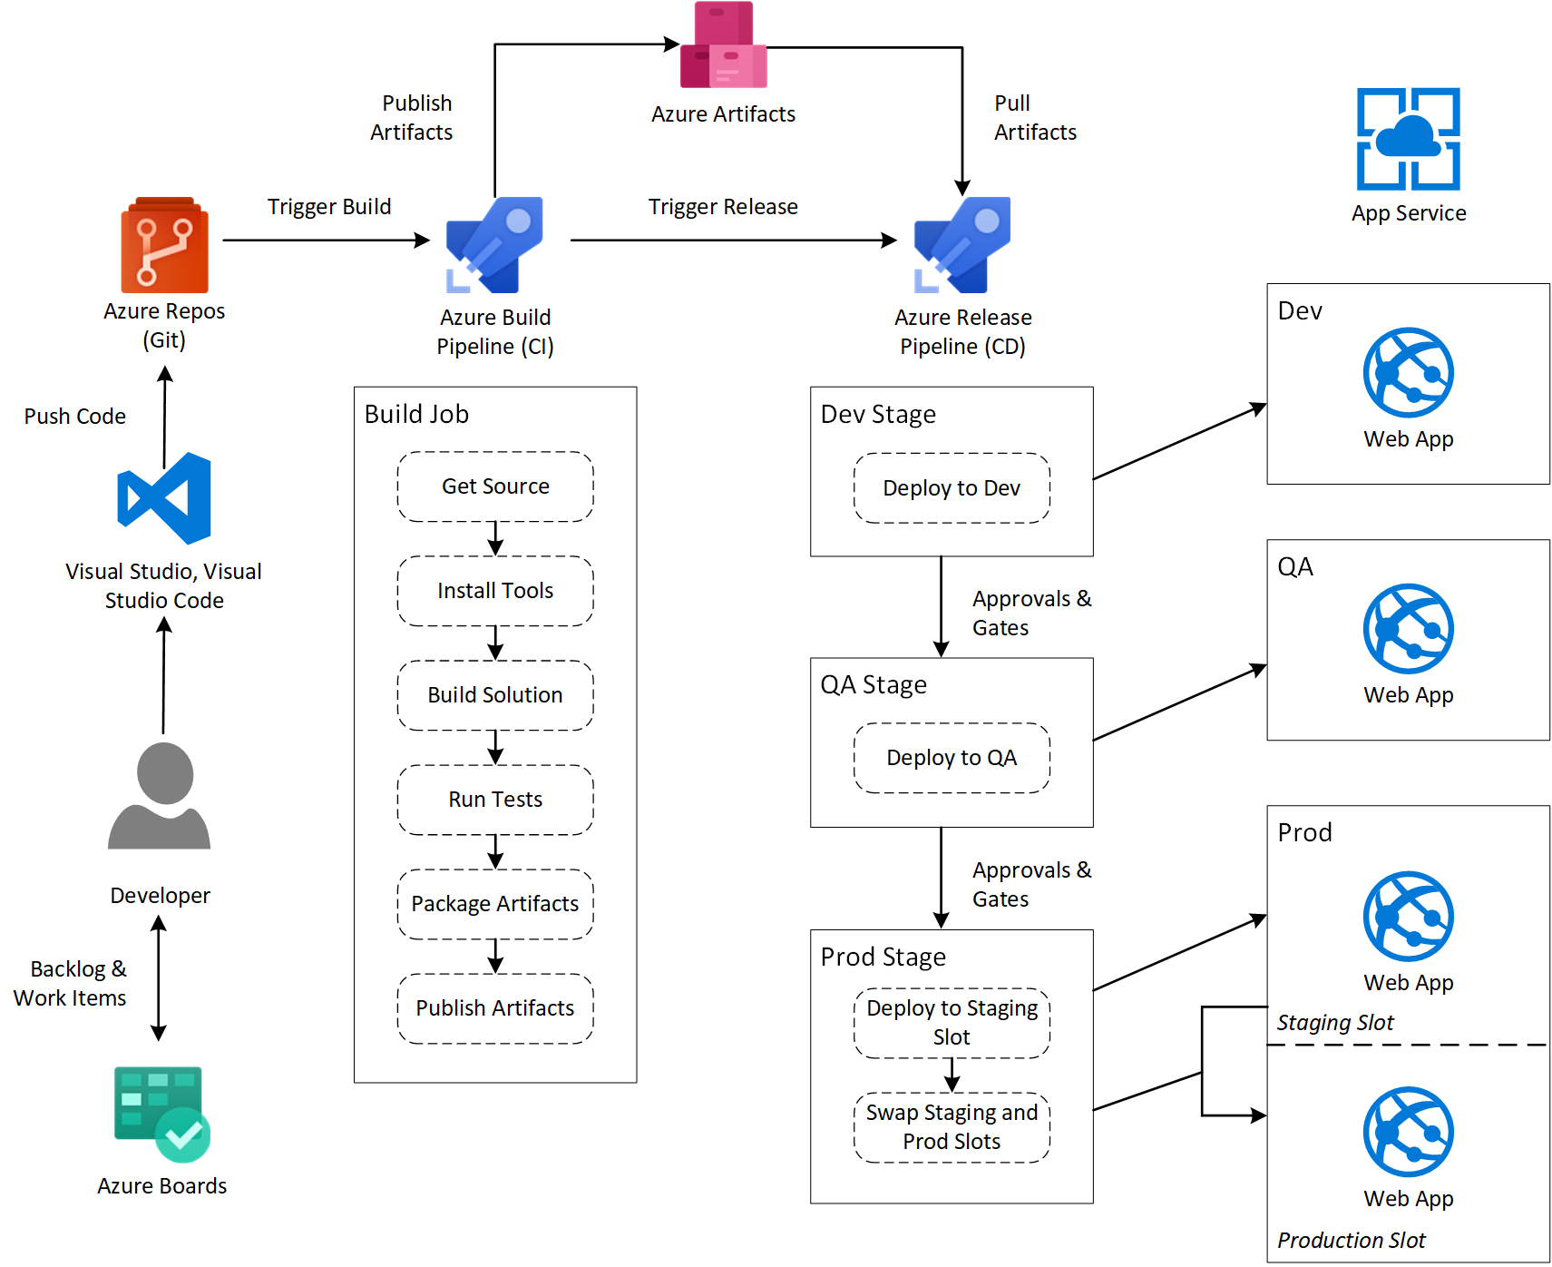

Slide 31
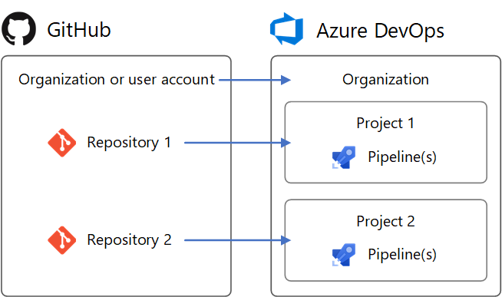

Slide 33
I have to talk about TFVC for 3 minutes
Upgrades
Large Binary Files
Rigid Structure
If you are upgrading from AX 2012, TFVC only supported path for code upgrade from LCS
TFVC handles versioning of large blobs better than Git.
While a negative for some, the rigid structure of TFVC can be desirable for some organizations with strict compliance or regulatory requirements
Notes:
https://learn.microsoft.com/en-us/dynamics365/fin-ops-core/dev-itpro/migration-upgrade/analyze-code-upgrade

Slide 34
I have to talk about TFVC for 3 minutes
Familiarity
Branching and Merging
Permissions
If your team is already familiar with centralized version control systems like then using TFVC might be a better choice as the concepts and workflow are similar.
TFVC can provide a simpler* and easier* to use branching and merging model than Git.
TFVC provides a stronger permissions model compared to Git

Slide 35
Setting Up a Git Repo

Slide 36
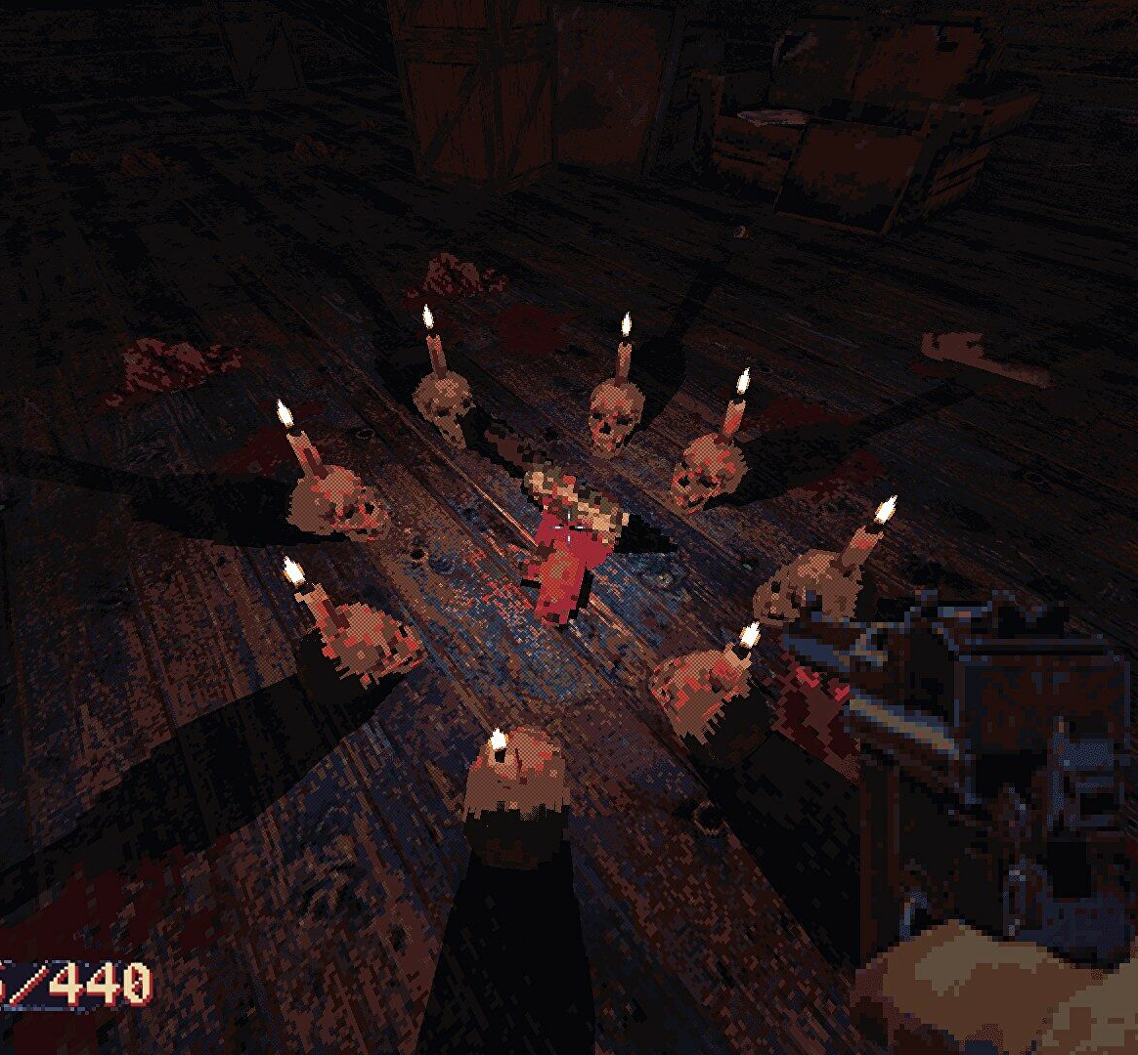
Github vs Azure DevOps (for Git)
Pipeline Syntax is different
Other than that, Git is Git

Slide 37
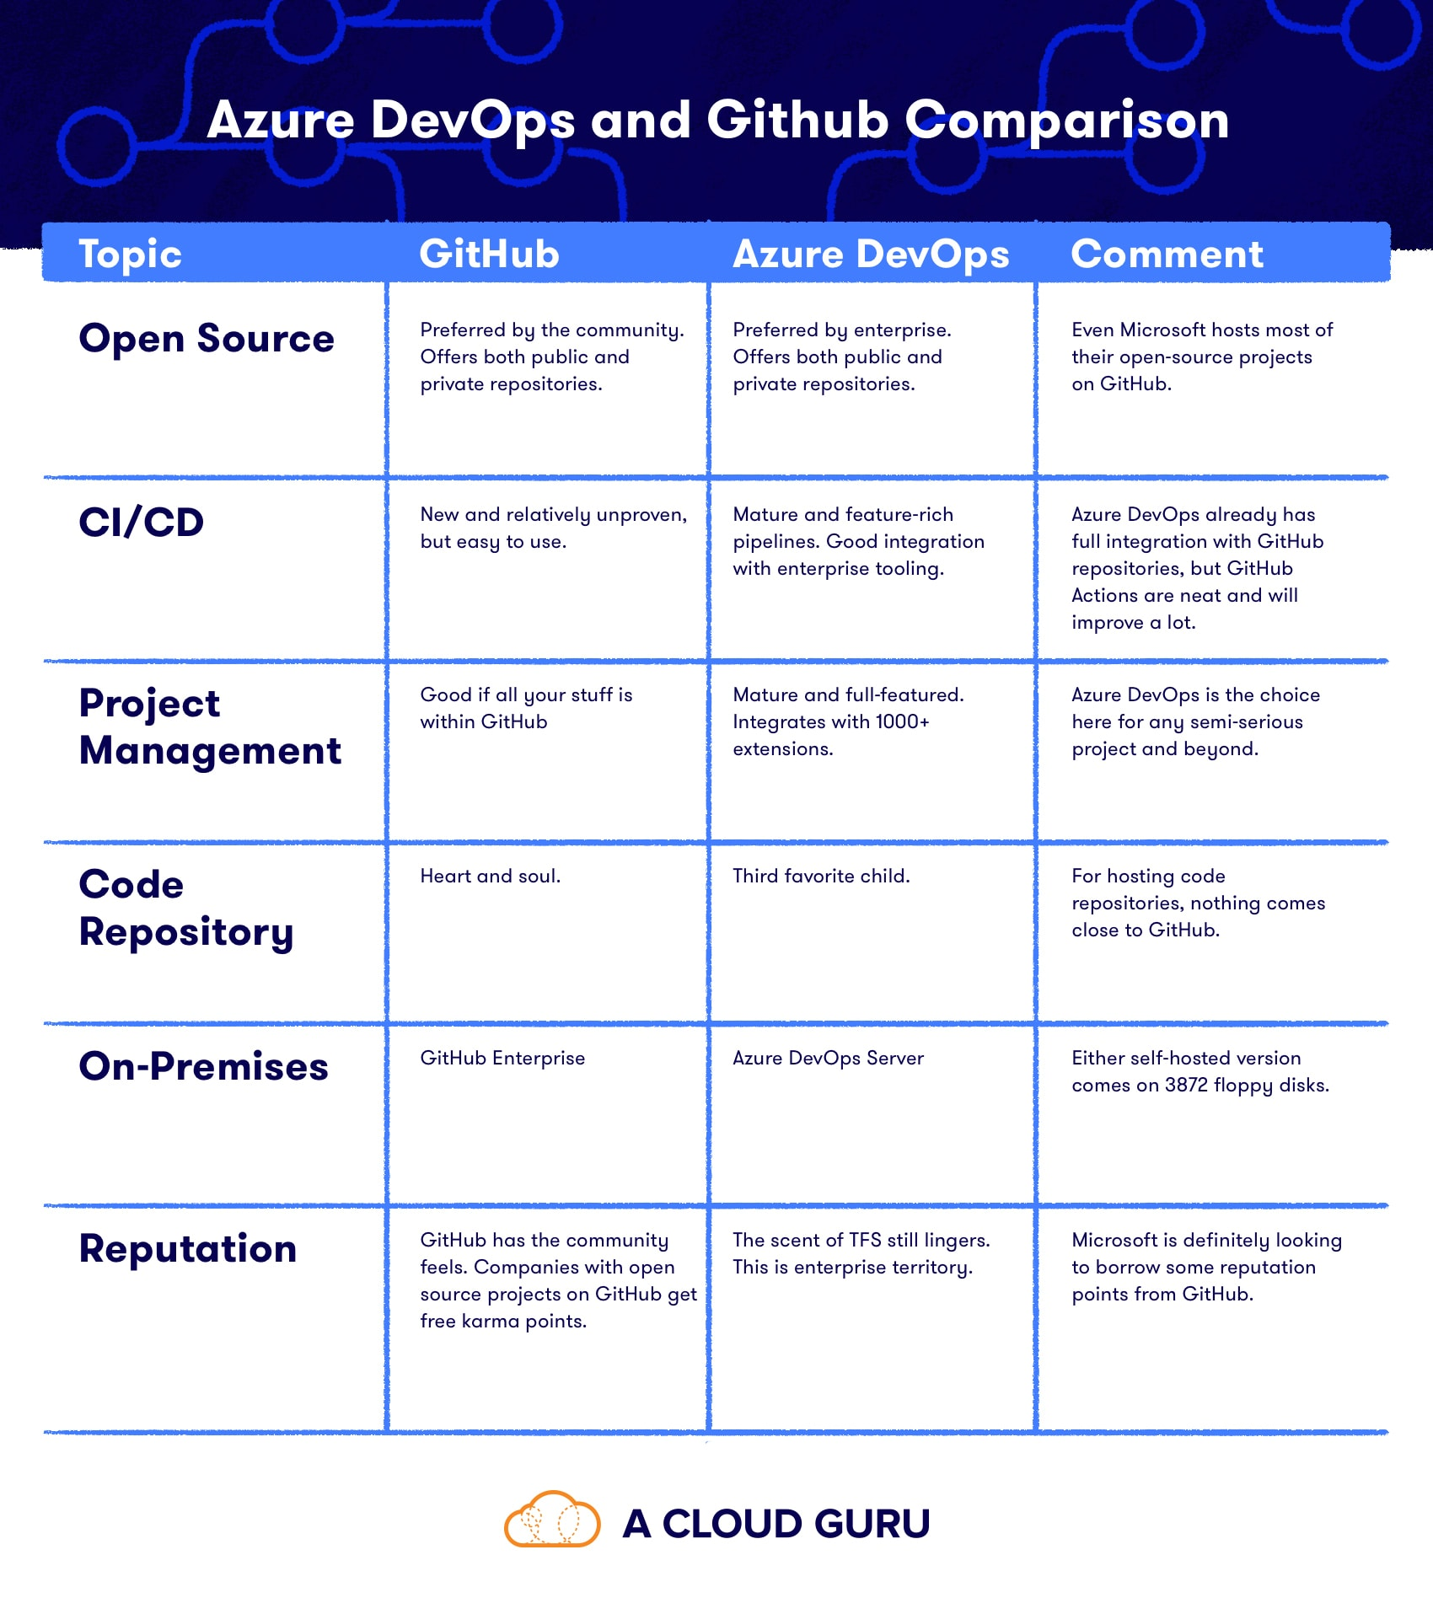
Git Vs DevOps Summary
Notes:
https://acloudguru.com/blog/engineering/azure-devops-vs-github-comparing-microsofts-devops-twins

Slide 38
Notes:
https://acloudguru.com/blog/engineering/azure-devops-vs-github-comparing-microsofts-devops-twins

Slide 39
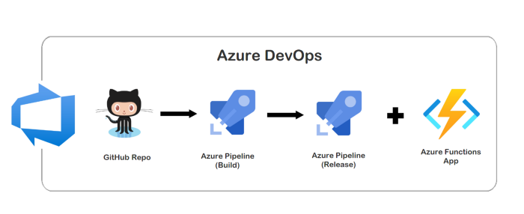
Notes:
https://levelup.gitconnected.com/ci-cd-for-azure-functions-app-by-using-github-and-azure-devops-c6ccfd0decaf

Slide 40
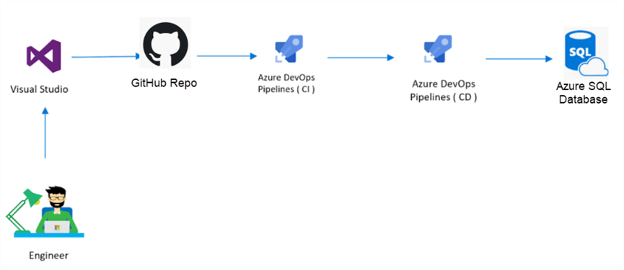

Slide 41
Source Control for Databases Too!

Slide 42
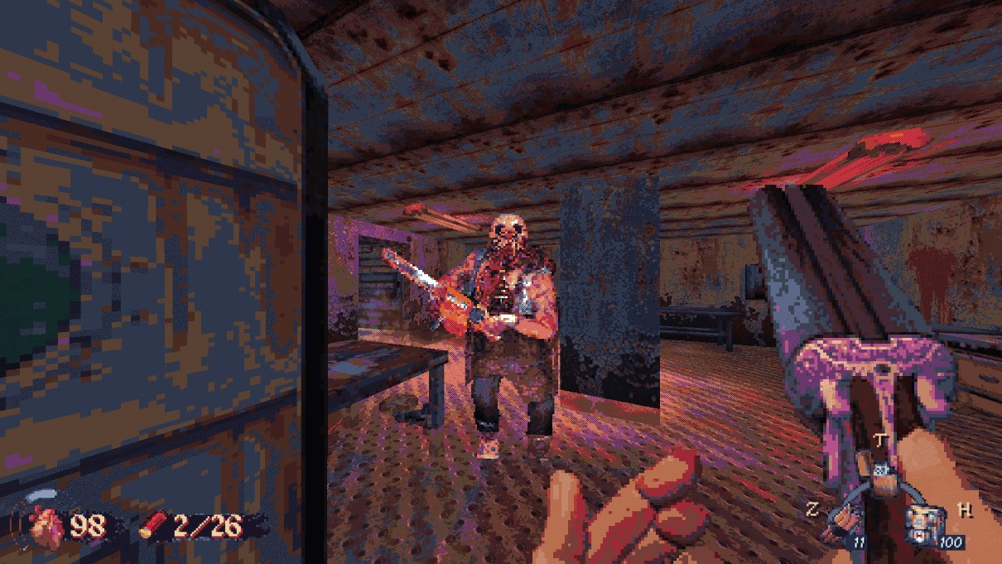
Create an Azure DevOps organization
If you don't already have an Azure DevOps organization, you'll need to create one. This can be done through the Azure DevOps portal.
https://learn.microsoft.com/en-us/azure/devops/organizations/accounts/create-organization?view=azure-devops
Notes:
https://learn.microsoft.com/en-us/azure/devops/organizations/accounts/create-organization?view=azure-devops

Slide 43
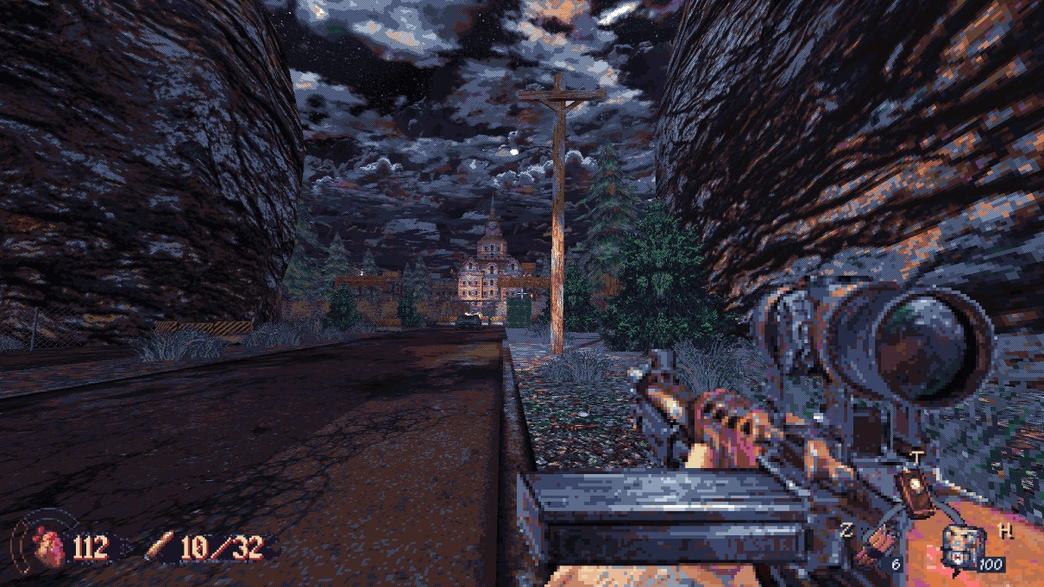
Create A Project
After creating an Azure DevOps organization, you'll need to create a project. This is where you'll store your code and work items
https://learn.microsoft.com/en-us/azure/devops/organizations/projects/create-project?view=azure-devops&tabs=browser#create-a-project
Notes:
https://learn.microsoft.com/en-us/azure/devops/organizations/projects/create-project?view=azure-devops&tabs=browser#create-a-project

Slide 44
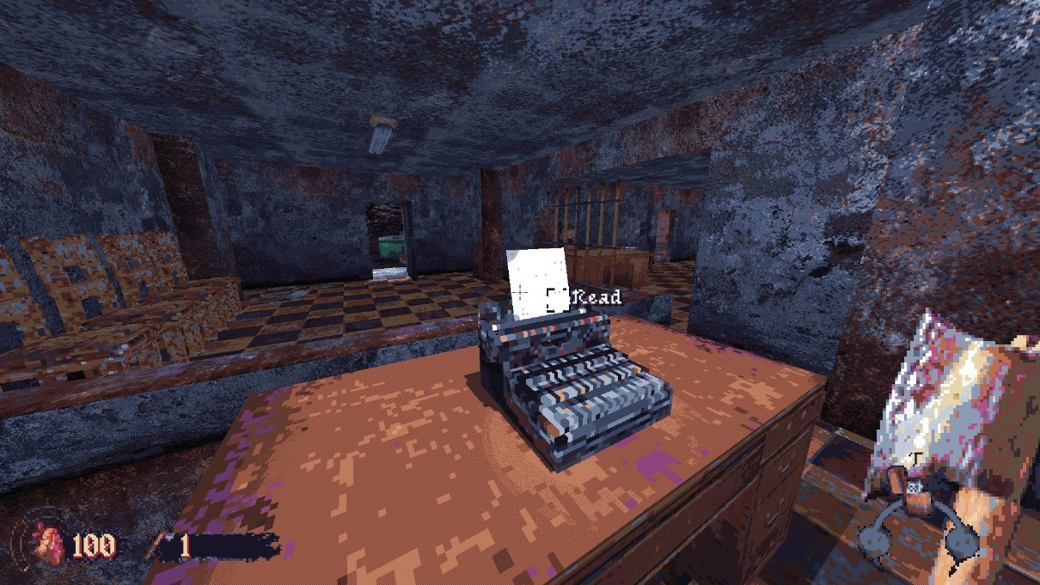
Install Git
In order to use Git with Azure DevOps, you'll need to install Git on your local machine
You can download the latest version from the Git website. Or you can use VS 2019. Or you can use VS 2015 or 2017 with the Git Add in.
https://git-scm.com/download/win
https://learn.microsoft.com/en-us/visualstudio/version-control/git-with-visual-studio?view=vs-2019#create-a-new-git-repository-in-visual-studio-2019
Notes:
https://git-scm.com/download/win
https://learn.microsoft.com/en-us/visualstudio/version-control/git-with-visual-studio?view=vs-2019

Slide 45
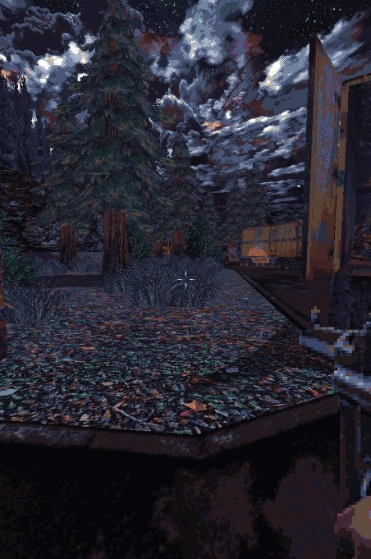
Connect to you Azure DevOps Project
Connect to Git with Command Line or Visual Studio
Once Git is installed, you can connect to your Azure DevOps project by using a Git client, such as the Git command line or a Git GUI client like Visual Studio. Visual Studio is recommended if you’re new to Git.
https://learn.microsoft.com/en-us/visualstudio/version-control/git-with-visual-studio?view=vs-2019#create-a-new-git-repository-in-visual-studio-2019

Slide 46
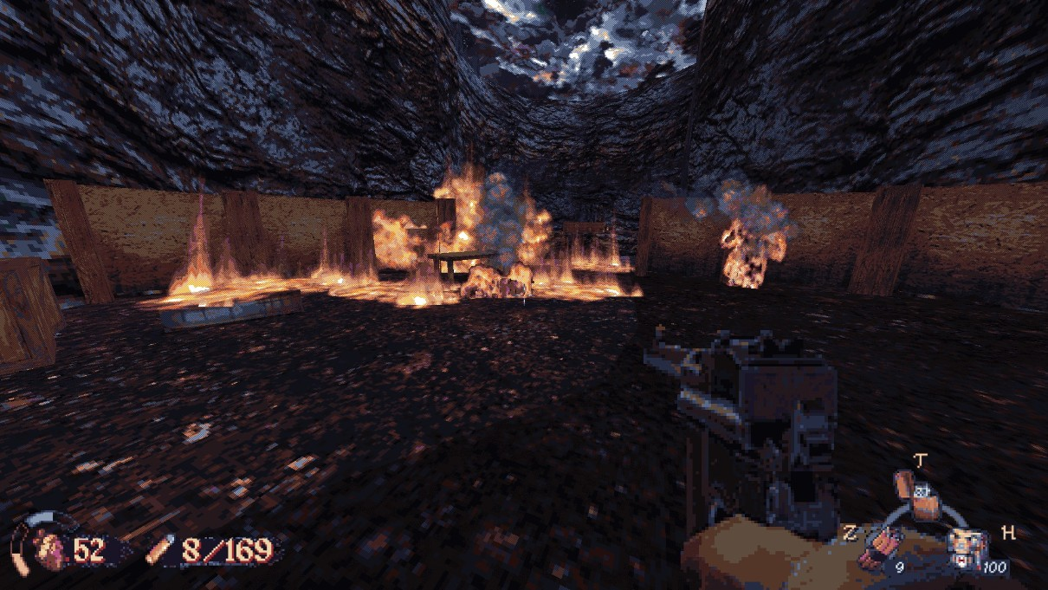
Clone the Repository
To start working with your code, you'll need to clone the repository.
This will create a local copy of the code on your machine that you can work with.
https://learn.microsoft.com/en-us/visualstudio/version-control/git-with-visual-studio?view=vs-2019#clone-an-existing-git-repository-in-visual-studio-2019

Slide 47
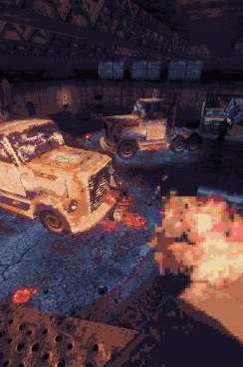
F&O Specific
Git and PackagesLocalDirectory don’t start out as friends...
You have to merge your Git directory with PackagesLocalDirectory manually and trick Git a little
https://www.atomicax.com/article/using-git-packageslocaldirectory

Slide 48
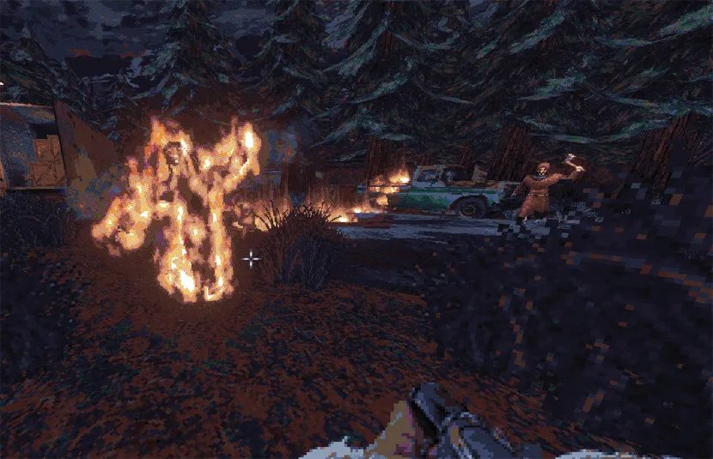
Pull changes from the repository
To get the latest changes from the repository, you can pull changes.
This will update your local copy of the code with the latest changes.
https://learn.microsoft.com/en-us/visualstudio/version-control/git-fetch-pull-sync?view=vs-2019

Slide 49
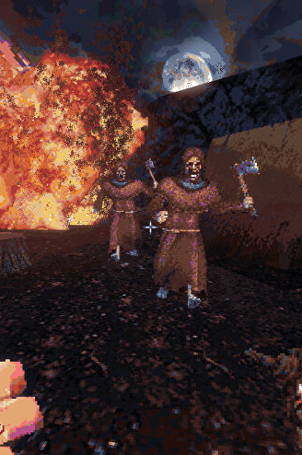
Push changes to the repository
After making changes to the code, you can push the changes to the repository
This will update the code in the Azure DevOps project.
https://learn.microsoft.com/en-us/visualstudio/version-control/git-make-commit?view=vs-2019

Slide 50

Start working with branches
If you want to work on a feature or bug fix, you can create a branch in Git.
This allows you to make changes to the code without affecting the main branch. A work area just for the item or task only for that item or task.
https://learn.microsoft.com/en-us/visualstudio/version-control/git-create-branch?view=vs-2019

Slide 51
Activity 2:
Use everything we just went through to create a project, repo with initialization, map it locally, add a yaml build pipeline and .gitignore.

Slide 52
Activity 3
Use Git Command Line to perform a push, pull, fetch, and sync. Also confirm what branch you are currently working in via command line. Find the same info in Visual Studio.
https://www.atlassian.com/git/tutorials/atlassian-git-cheatsheet

Slide 53
Best practices for using Git in Azure DevOps

Slide 54
Best practices
01
03
Create one repository for each project
Commit often
This will help you manage and track changes to the code more effectively.
Commit changes frequently to the repository to keep track of changes and make it easier to revert if necessary.
02
04
Use branching and merging
Use descriptive commit messages
Use branches to isolate changes, and merge changes back into the main branch when they're ready.
Use meaningful commit messages to describe changes and make it easier to understand the history of the codebase.

Slide 55
Best Practices
05
07
Use code reviews
Keep the repository clean
Have a code review process in place, where changes are reviewed by other team members before being merged into the main branch. Include in the Pull Request (PR) process.
Regularly clean up the repository by removing old branches and cleaning up the history. We’re going to talk more about this later.
06
08
Avoid committing large binary files
Use tags to mark releases
Large binary files can slow down Git operations and consume storage. Store large binary files separately and track them outside of Git if necessary. Hint: use Azure Artifacts.
Use tags to mark important points in the development history, such as releases, to make it easier to identify and track releases.

Slide 56
Tagging
What is a Tag?
It's a way to mark important points in the project's development, such as releases, milestones, or significant changes.
A Lightweight tag is just a marker of some kind like V1.0 or similar.
A annotated tag has a comment along with the marker like V1.0 with a comment “first production release”.

Slide 57
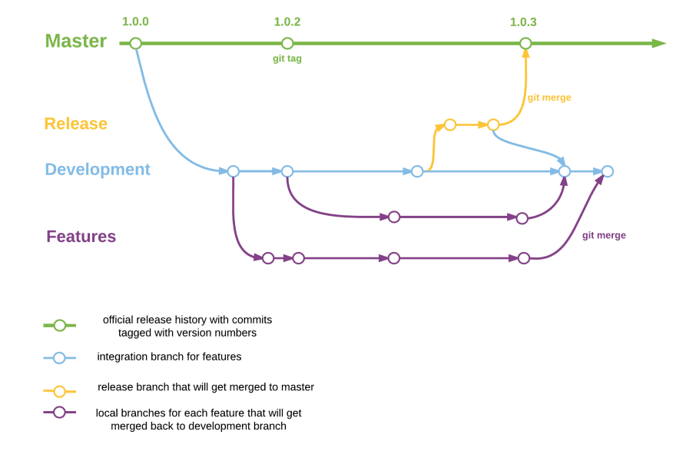
Notes:
https://dev.to/saurabhpro/git-tags-ftw-1i77

Slide 58
Notes:
https://dev.to/saurabhpro/git-tags-ftw-1i77

Slide 59
Notes:
https://dev.to/saurabhpro/git-tags-ftw-1i77

Slide 60
09
10
Integrate with the rest of your development process
Educate your team
Integrate Git with the rest of your development process, such as continuous integration and deployment (CI/CD), to automate the deployment of code changes.
Ensure that all team members are familiar with Git and understand best practices, such as these, to ensure that everyone is working efficiently and effectively.

Slide 61
Source Control Branching Strategies

Slide 62

Git Concepts
Branches
Exactly like in TFVC today in concept.
Pointer to a specific point in time of a branch
When you create a branch, you create a new pointer that tracks changes to the repository independently from other branches.

Slide 63


Slide 66

Git Concepts
Forks (or Forking)
A fork is a complete copy of a Git repository that is stored in a different location.
When you fork a repository, you create a new independent repository.
Forks allow you to make changes to a repository without affecting the original repository

Slide 67
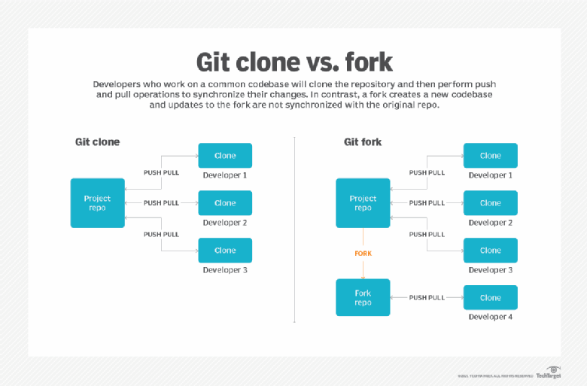
Notes:
https://www.theserverside.com/blog/Coffee-Talk-Java-News-Stories-and-Opinions/command-line-GitHub-fork-CLI-terminal-shell

Slide 68
Notes:
https://www.theserverside.com/blog/Coffee-Talk-Java-News-Stories-and-Opinions/command-line-GitHub-fork-CLI-terminal-shell

Slide 69
Notes:
https://www.theserverside.com/blog/Coffee-Talk-Java-News-Stories-and-Opinions/command-line-GitHub-fork-CLI-terminal-shell

Slide 70

Git Concepts
Pull Requests (PRs)
A pull request is a feature in Git that allows users to submit changes to a repository for review and integration into the main codebase.
A signal mechanism that development is complete in the branch (typically)
Ready for review, acceptance, and merge into target branch
Can Reject, Accept with actionable feedback, or Accept

Slide 71
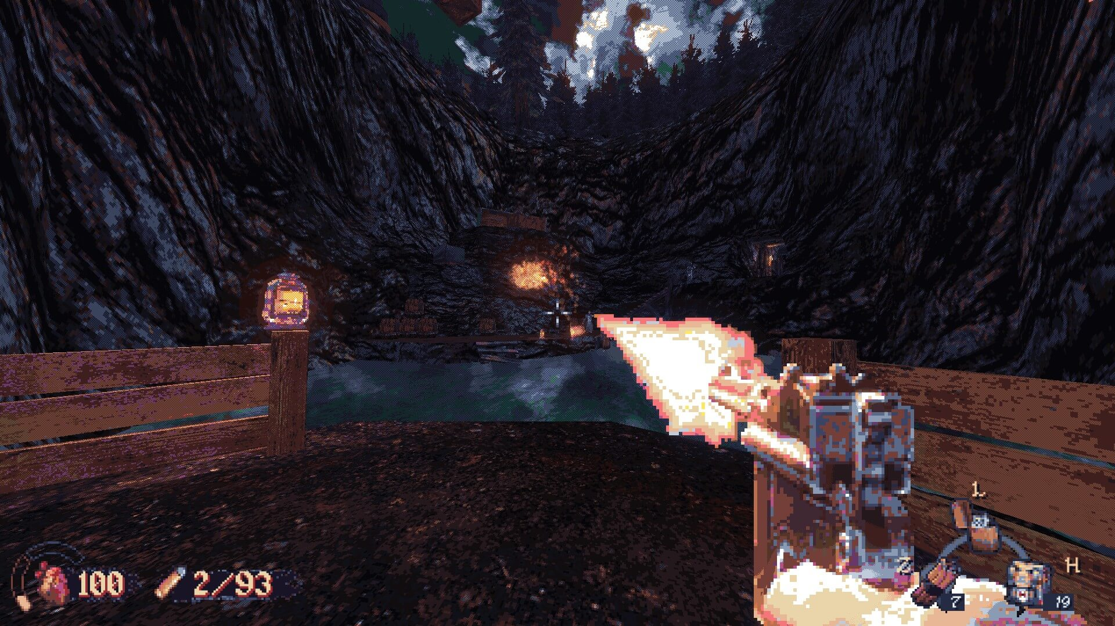
Pull Requests (PRs)
Create a Work Item in DevOps
Work Item for FDD/TDD so we can measure what is delivered against a request
Create a Branch from the Work Item
A work area for that specific FDD/TDD usually for 1 F&O Developer
Switch To that Branch in VS
Use the work area given for the requests changes
Do the work
Code, Commit, and Test, Code again, Test again, and Commit again.
Create a Pull Request (PR)
Signal that you work is complete, optionally get feedback

Slide 72

Overview of Branching Strategies
Gitflow
A popular branching strategy that involves creating a main branch for production code, a develop branch for integration, and feature branches for individual features.
Trunk-Based Development
A simple branching strategy where all changes are made directly to the main branch (trunk)
Feature Toggle
A branching strategy that involves using feature flags or toggles to enable or disable specific features in code.
Forking
A branching strategy where a separate branch (fork) is created for each contributor to work on.
Task or Topic branching
A branching strategy where a separate branch is created for each task or bug fix.

Slide 73
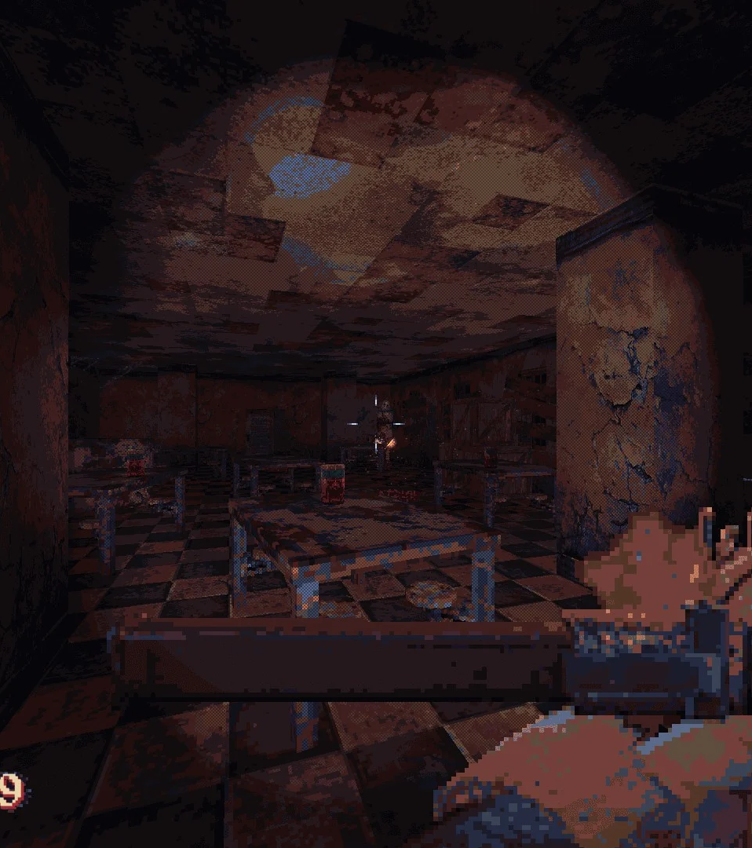
GitFlow
What most everyone seems to use
Flexible
Make it how you want it
Semi-unstructured (in my opinion)
Potentially lots of branches
Potentially complex
“Potential”
Best for complex products, with lots of developers and PMs

Slide 74
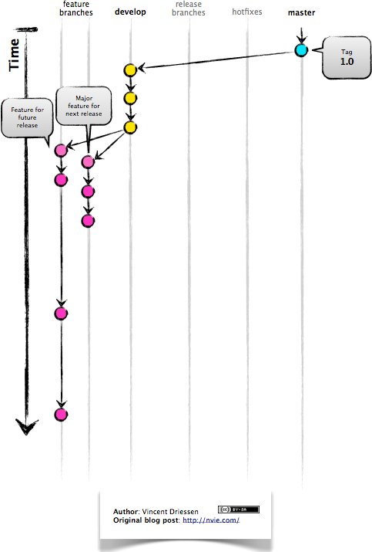
Notes:
http://datasift.github.io/gitflow/IntroducingGitFlow.html

Slide 75
Notes:
http://datasift.github.io/gitflow/IntroducingGitFlow.html

Slide 76
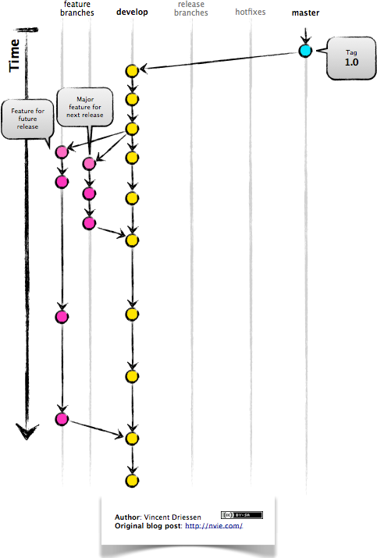
Notes:
http://datasift.github.io/gitflow/IntroducingGitFlow.html

Slide 77
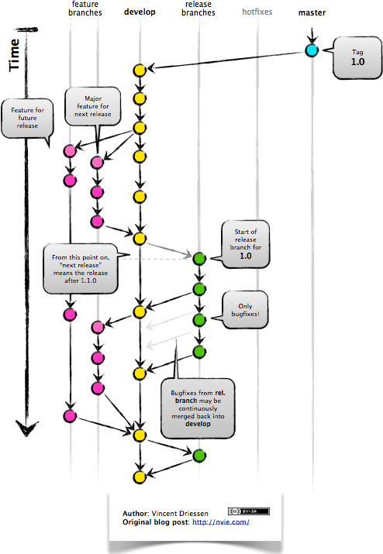
Notes:
http://datasift.github.io/gitflow/IntroducingGitFlow.html

Slide 78
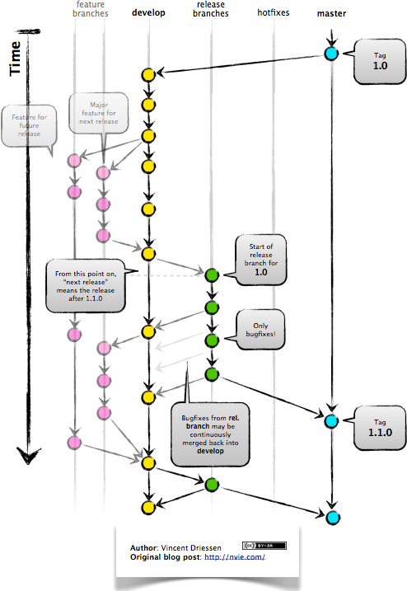
Notes:
http://datasift.github.io/gitflow/IntroducingGitFlow.html

Slide 79
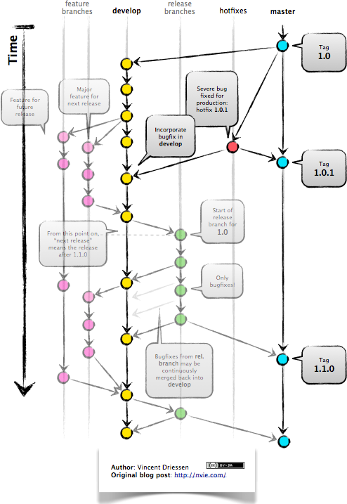
Notes:
http://datasift.github.io/gitflow/IntroducingGitFlow.html

Slide 80
Notes:
http://datasift.github.io/gitflow/IntroducingGitFlow.html

Slide 81
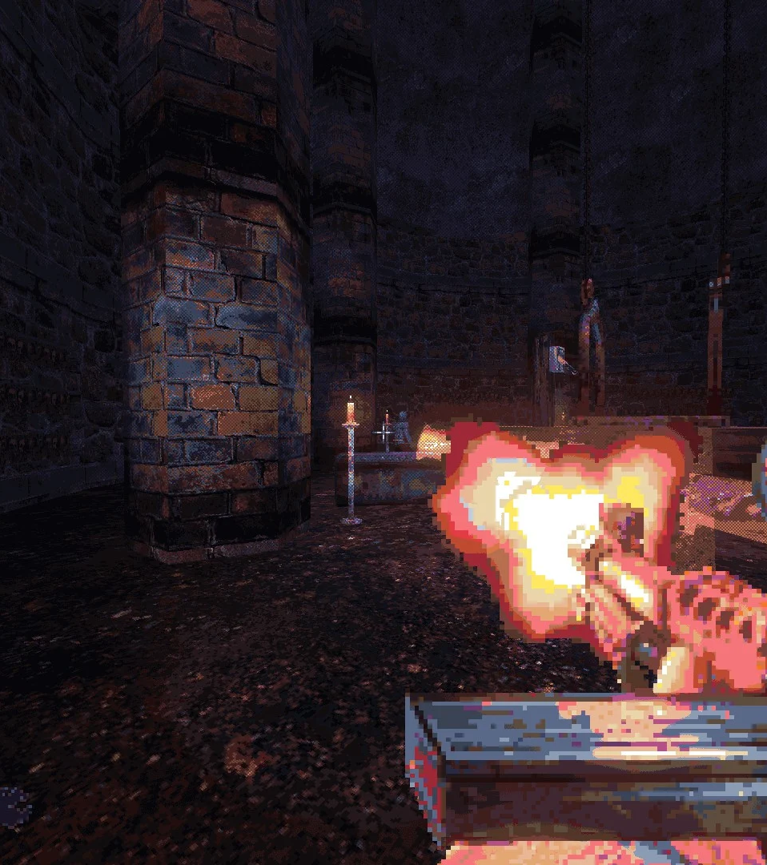
Trunk-Based Development
Git for Small Teams
No branching for development
Only Release branches
Every committer is making small commits straight to main/trunk branch
All commits must pass automation (build, test, etc.)
Best for Agile teams continuous delivering new releases

Slide 82
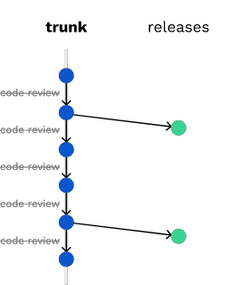

Slide 84
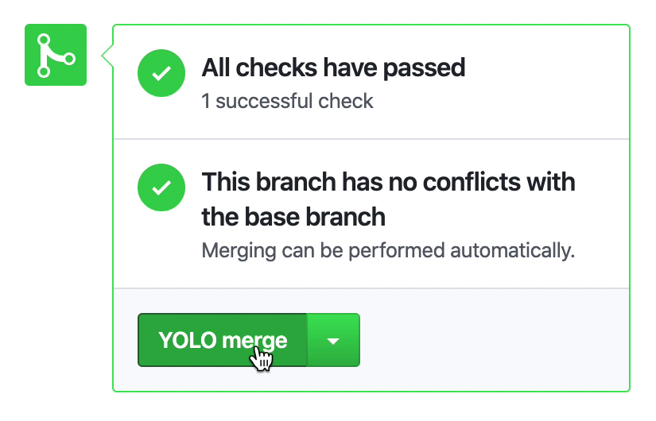

Slide 86

Feature Toggle
Toggle to turn new thing on or off
This strategy allows teams to work on features in parallel and release them independently
Very similar to F&O Feature Management
Code is there
You have to turn it on with a config
Best for rolling out features gradually with limited risk

Slide 87
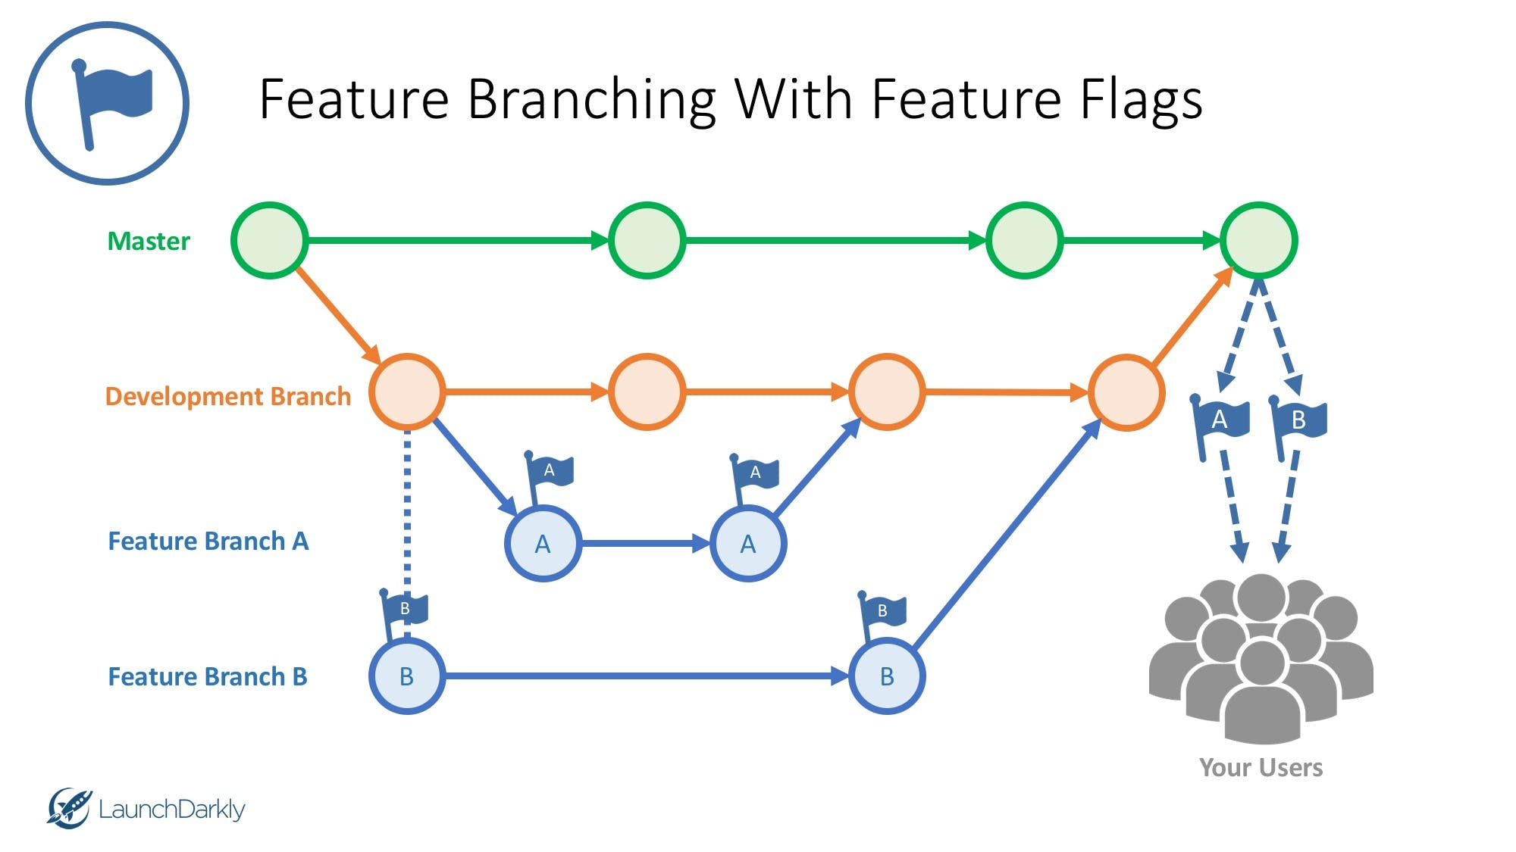
Notes:
https://launchdarkly.com/blog/feature-branching-using-feature-flags/

Slide 88
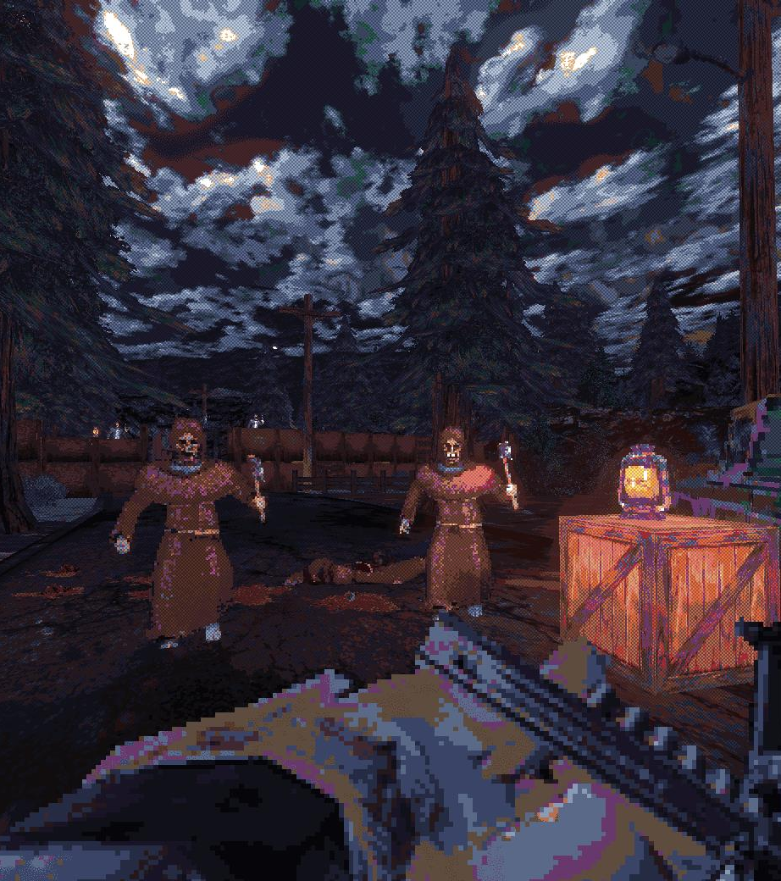
Forking
Open Sourcey Git
Common for open-source projects
Look at nearly every public repo on GitHub*
Not a good fit for F&O
Just being thorough

Slide 89
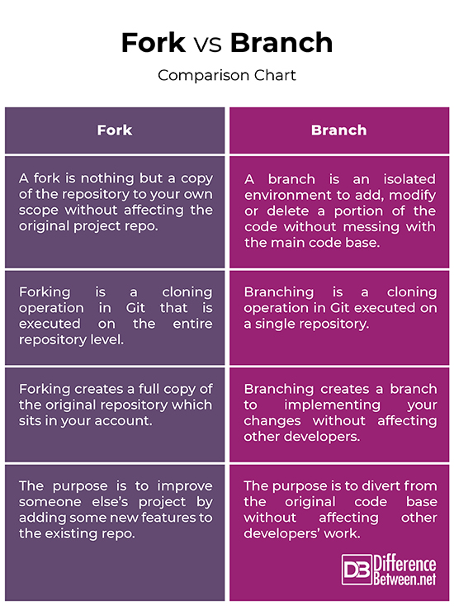

Slide 92
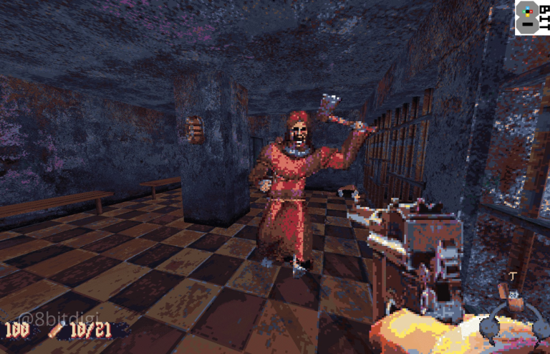
Task or Topic Branching
Toggle-less Feature Development
A branching strategy where a separate branch is created for each task or bug fix
This strategy helps to isolate changes and makes it easier to revert if necessary.
Compatible with Feature Toggling – Toggle is just set to on always by default

Slide 93

Task or Topic Branching
Toggle-less Feature Development
Best for working multiple features simultaneously
... With a short term large team of developers
... With a code review process
... And the need for testing changes in isolation as well as part of a process
What does this sound like?

Slide 94
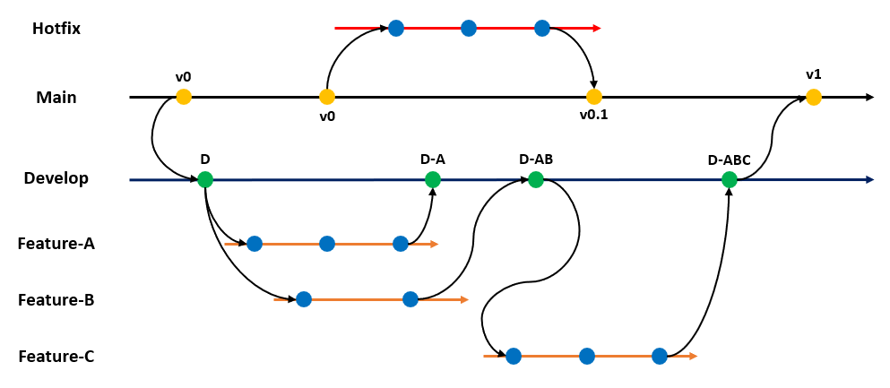

Slide 96
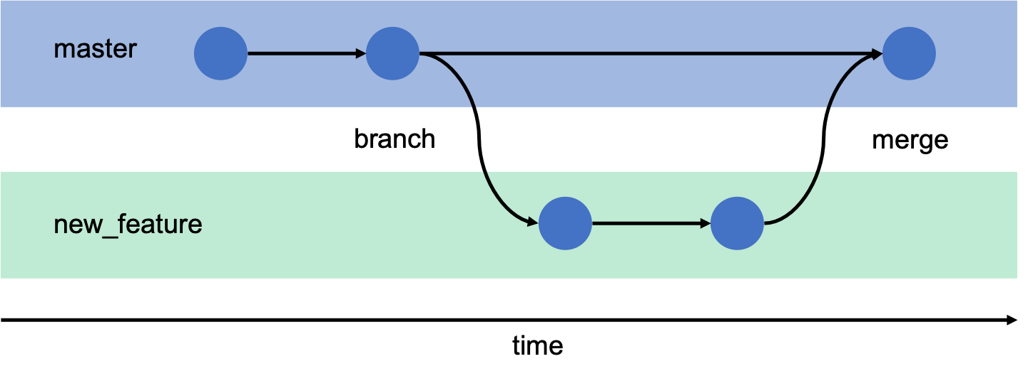

Slide 98
Pulling and Resolving conflicts in Git
Use a (better) Merge tool
Use the command line
Best way to merge conflicts? Prevent them.

Slide 99
Merge Tools
Lots of Options Available
Use a merge tool, such as Git's built-in merge tool or a third-party tool, to resolve conflicts effectively and efficiently.
Visual Studio ships with one
So does Command Line Git
Other Options available like WinMerge that can be integrated with both
Whatever works best for you
VS: https://learn.microsoft.com/en-us/azure/devops/repos/git/merging?view=azure-devops&tabs=visual-studio-2019-git-menu#resolve-merge-conflicts-1

Slide 100
Command Line Git
Merge with Command Line Git
Not recommended for novices
More control overall
Should rarely have to do this unless you just like the command line
More Info: https://learn.microsoft.com/en-us/azure/devops/repos/git/merging?view=azure-devops&tabs=git-command-line#resolve-merge-conflicts-1
Notes:
https://learn.microsoft.com/en-us/azure/devops/repos/git/merging?view=azure-devops&tabs=git-command-line#resolve-merge-conflicts-1

Slide 101
Rebase instead of merging
Rebasing is the process of moving or combining a sequence of commits to a new base commit.
Combine commit A, B, C, D, E, and F into commit G.
Reduces number of commits overall
Help keeps the commit history linear and reduce number of merge conflicts

Slide 102
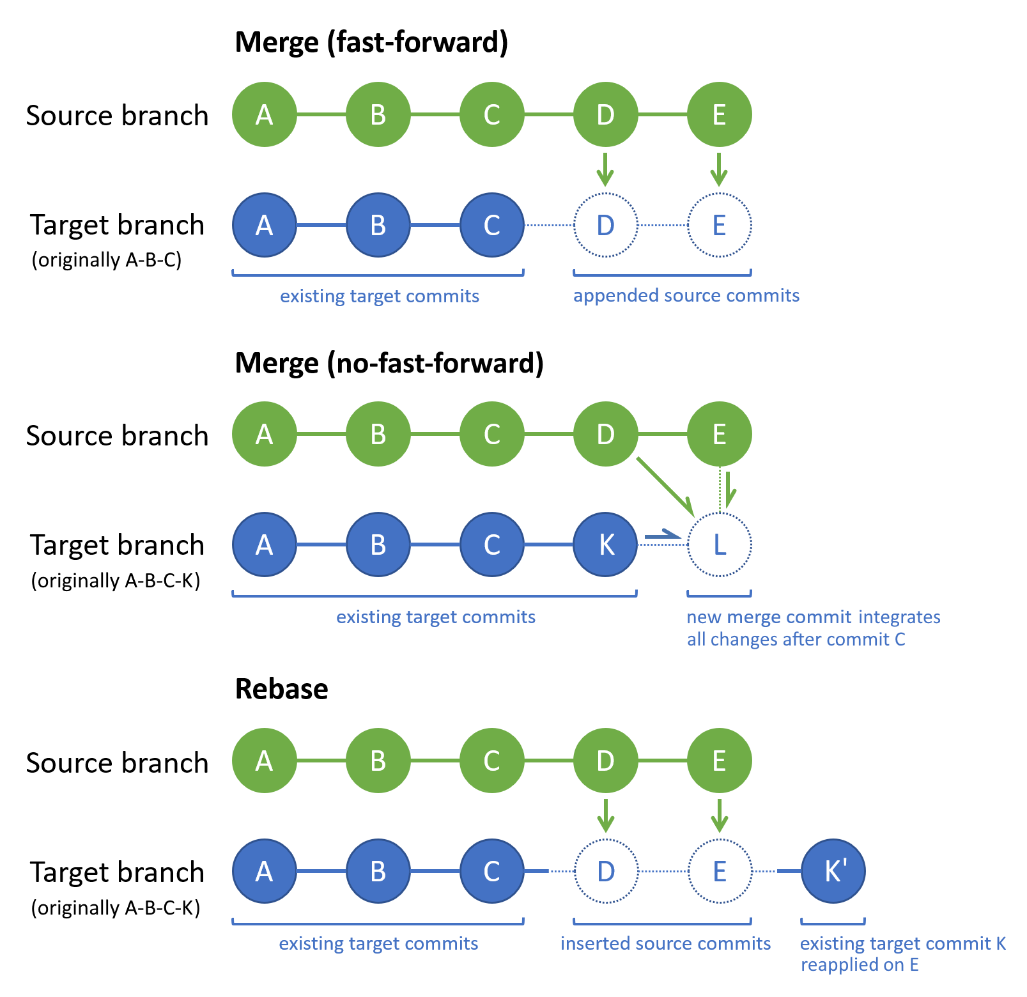
Notes:
https://learn.microsoft.com/en-us/azure/devops/repos/git/merging?view=azure-devops&tabs=git-command-line#understand-merge-conflicts

Slide 103
Notes:
https://learn.microsoft.com/en-us/azure/devops/repos/git/merging?view=azure-devops&tabs=git-command-line#understand-merge-conflicts

Slide 104
Notes:
https://learn.microsoft.com/en-us/azure/devops/repos/git/merging?view=azure-devops&tabs=git-command-line#understand-merge-conflicts

Slide 105
Activity 4 – Implement Topic Branching
Create work item
Create branch for work item
Sync to VS
Make and commit changes
Create pull request
Approve pull request

Slide 106
Activity 5 – Create and resolve Merge Conflict

Slide 107
Activity 6 – Branching Strategies

Slide 108
Managing Dependencies and artifacts
You can automate the process of building X++ code and creating deployable packages on any build agent that run on Microsoft Windows.
Notes:
https://learn.microsoft.com/en-us/dynamics365/fin-ops-core/dev-itpro/dev-tools/hosted-build-automation

Slide 109
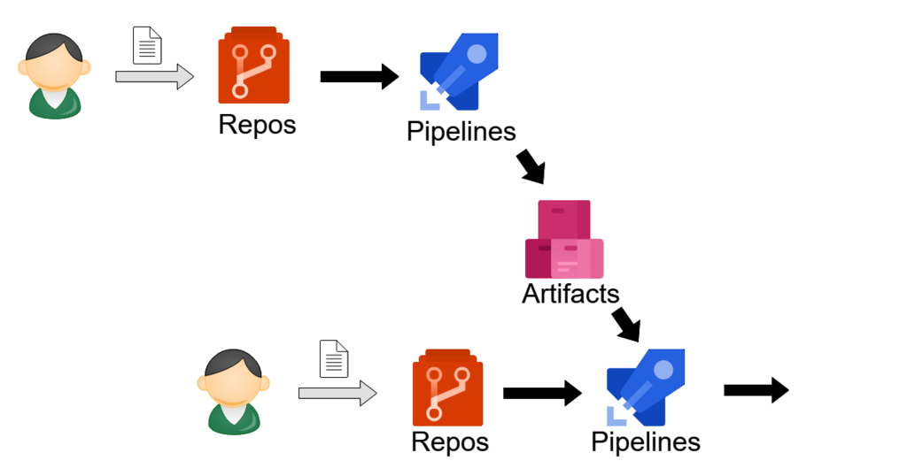
Notes:
https://nkshigeru.hatenablog.com/entry/2019/01/31/160000

Slide 110
Notes:
https://nkshigeru.hatenablog.com/entry/2019/01/31/160000

Slide 111
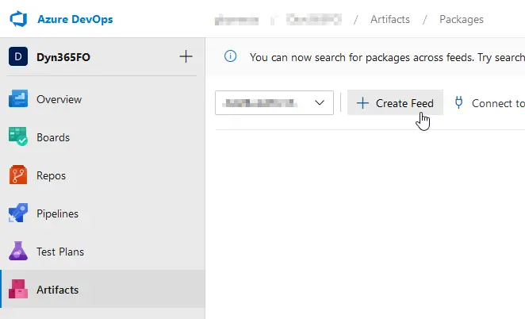
Notes:
https://ariste.info/en/dynamics365almguide/azure-devops-artifacts/

Slide 112
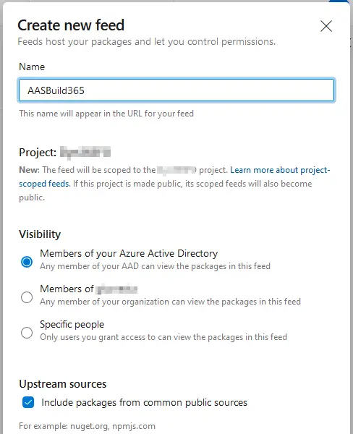
Notes:
https://ariste.info/en/dynamics365almguide/azure-devops-artifacts/

Slide 113
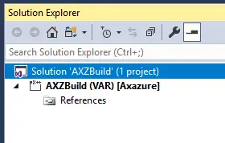
Notes:
https://ariste.info/en/dynamics365almguide/prepare-azure-devops/

Slide 114
Notes:
https://ariste.info/en/dynamics365almguide/prepare-azure-devops/

Slide 115
Build Pipelines

Slide 116
Build Pipeline - Definition
On AZ-204, AZ-400
Build pipelines are defined using YAML or a visual editor in Azure DevOps. You can define the steps required to compile, build, and test your code, as well as configure the environment and tools required to perform these steps.

Slide 117
Build Pipeline - Trigger
On AZ-204, AZ-400
Build pipelines can be triggered automatically in response to code changes or on a schedule. You can also trigger a build pipeline manually

Slide 118
Build Pipeline - Stages
On AZ-204, AZ-400
Build pipelines consist of one or more stages, each of which performs a specific task, such as compiling code, running tests, or deploying code.

Slide 119
Build Pipeline - Tasks
On AZ-204, AZ-400
Stages consist of one or more tasks, which are the individual steps that perform the actions required to build, test, and deploy code. There are many built-in tasks in Azure DevOps, such as tasks for building code, running tests, and deploying code, and you can also create custom tasks.

Slide 120
Build Pipeline - Artifacts
On AZ-204, AZ-400
Build pipelines can produce artifacts, such as compiled code, test results, and documentation, which can be used by other stages in the pipeline or by release pipelines.

Slide 121
Build Pipeline - Integration
On AZ-204, AZ-400
Build pipelines can be integrated with other parts of the development process, such as source control, testing, and deployment.

Slide 122
Setting Up a Build Pipeline
Start with Templates
Update As Needed
Templates Are a Good Starting Point
Use templates from Microsoft or community
https://github.com/microsoft/Dynamics365-Xpp-Samples-Tools/tree/master/CI-CD/Pipeline-Samples
Microsoft introduces new build artifacts with every release
Sometimes those contain bugs or issues
Manage build pipelines with your Artifacts
Templates are a good place to start
Modify to do what you need
Create specialize build pipelines for specific scenarios

Slide 123
Activity 7 – Create and Configure a Build pipeline
Notes:
https://ariste.info/en/dynamics365almguide/configure-pipeline/
https://ariste.info/en/dynamics365almguide/azure-devops-artifacts/

Slide 124
Build Pipeline Types
DevOps Build Service / Cloud Build Service
Dedicated Build Server
Dynamically Created Build Server

Slide 125
DevOps Build Service
Microsoft Hosted
No Database (or other AOS components)
Just a Compile
Can Create a deployable Package
No Tests
Good For: Standard Package Builds
Good For: Builds after each commit, before/after PR

Slide 126
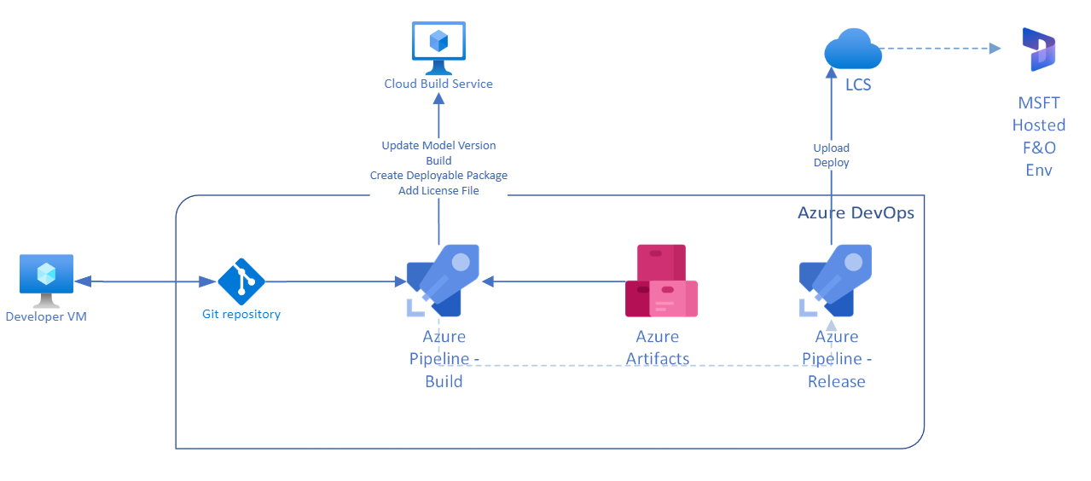

Slide 129
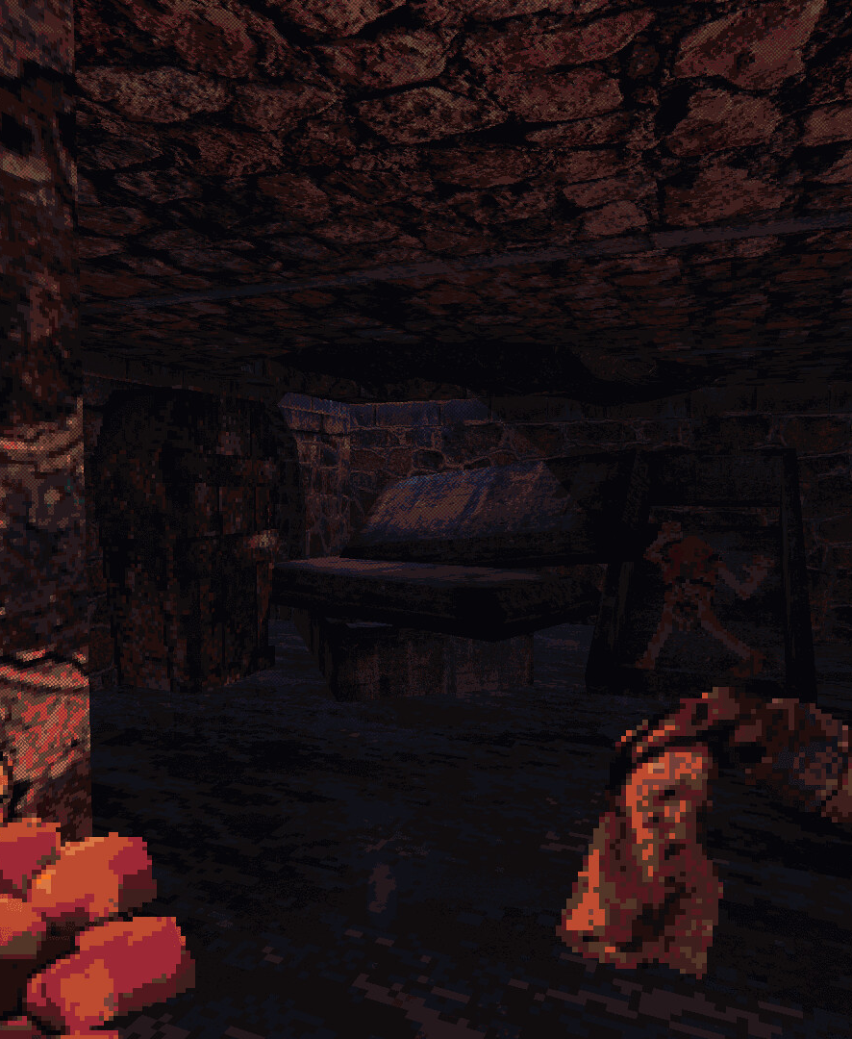
Dedicated Build Server (On Prem or In Cloud)
Self Hosted
Has a Database and all AOS components
Compile, Create Package, Tests, RSAT, all Features
VM on Azure Sub, On Prem Dev VM managed like any other build VM in LCS/Azure
Good For: Build, Sync, test
Should only be used for activities that require the full app, like testing
... or if you run out of minutes with MSFT on the free pipeline.
Notes:
Currently 1800 minutes for free. Every Visual Studio Enterprise subscriber in your company means you get 1 Self Hosted Pipeline for free

Slide 130
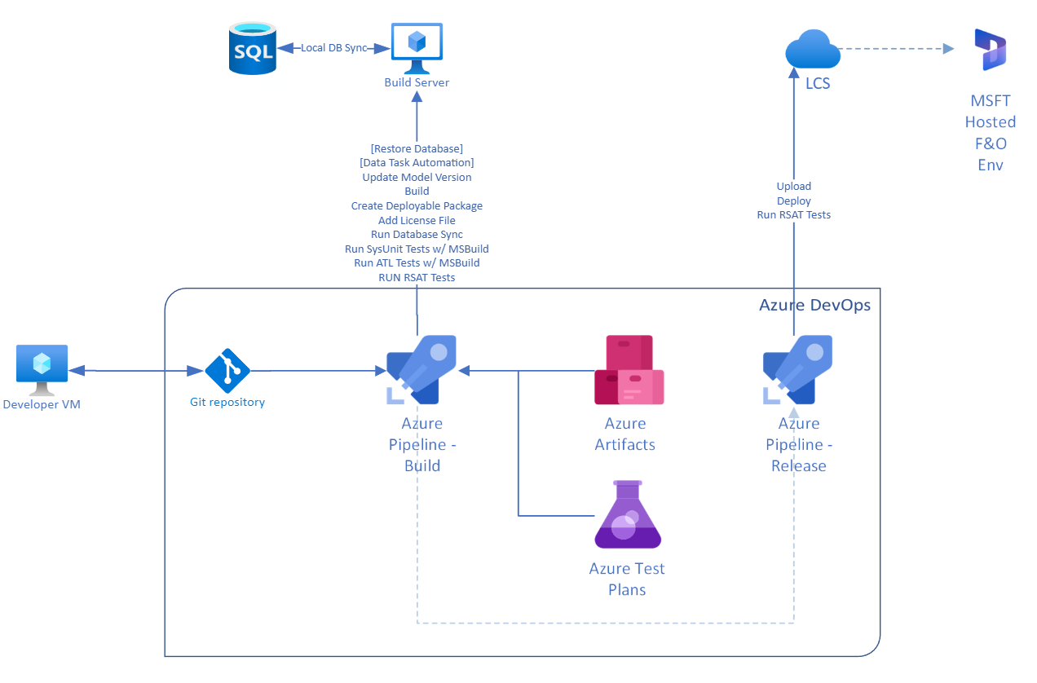

Slide 133
Dynamically created build machine
Build on request
Has a Database and all AOS components
Compile, Create Package, Tests, RSAT, all Features
VM on Azure Dev/Test Sub, not connected to LCS, created from VHD Template
Template needs to be updated periodically so builds are on semi current version
Good For Build, Sync, test
Complicated. Ideal for complex implementations so multiple pipeline instances can be running
Notes:
https://ariste.info/en/2021/02/azure-devtest-labs-build-dynamics-365-fno/

Slide 134
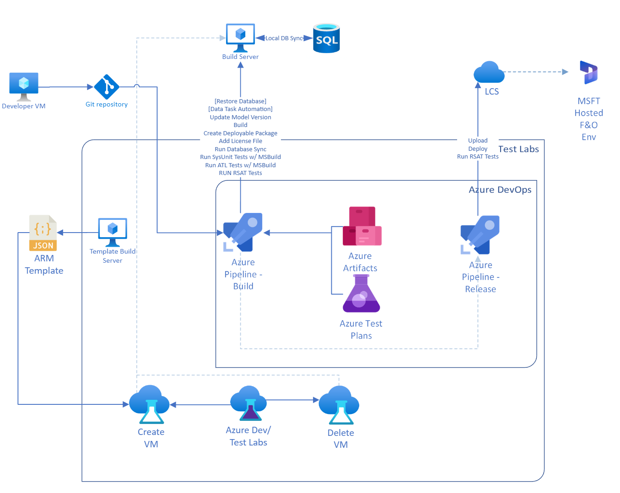

Slide 142
Pipelines Best Practices
01
03
Use version control for pipeline definitions
Use templates
Store your pipeline definitions in version control, such as Azure Repos, to enable collaboration, track changes, and revert to previous versions if needed.
Use templates to reuse common pipeline components, such as environment definitions, across multiple pipelines. https://github.com/microsoft/Dynamics365-Xpp-Samples-Tools/tree/master/CI-CD/Pipeline-Samples
02
04
Keep pipelines simple
Use multi-stage pipelines
Keep your pipelines simple and focused on a specific goal. Avoid creating overly complex pipelines that are difficult to understand and maintain.
Use multi-stage pipelines to divide your build process into multiple stages, such as build, test, and deploy, making it easier to manage and visualize your pipeline.
Notes:
01: pipelines are code, code can’t be changed in Main, have to create a branch for a pipeline change, the PR will create a build request with the pipeline you made. It is self testing.
02: Build in azure hosted; build and package in Azure hosted; Build and test in self hosted build machine; Build, test, package in on demand build machine
03: https://github.com/microsoft/Dynamics365-Xpp-Samples-Tools/tree/master/CI-CD/Pipeline-Samples

Slide 143
Pipelines Best Practices
05
07
Automate testing
Monitor and improve pipeline performance
Automate testing as much as possible to catch issues early in the development process. Use tools such as Azure Test Plans to manage your testing efforts. Stuff like ATL, SysUnit, RSAT
Monitor the performance of your pipelines and optimize the build process to reduce build time and increase efficiency. *Only for Build Projects*
06
08
Use approvals
Document your pipelines
Use approvals to require manual approval before proceeding to the next stage, such as deploying to UAT, to enforce compliance and quality standards.
Document your pipelines, including pipeline definitions and the reasoning behind pipeline design decisions, to ensure that other team members can understand and maintain the pipelines in the future. Use ChatGTP.
Notes:
06: https://www.programmingwithwolfgang.com/deployment-approvals-yaml-pipeline/
07: https://learn.microsoft.com/en-us/azure/azure-monitor/app/continuous-monitoring

Slide 144
Code Coverage
“Code Coverage”
Code coverage is a measure of how much of the source code of a program has been executed, tested, and validated.
insights into the thoroughness of testing

Slide 145
Microsoft Dynamics 365 Finance and Operations code coverage
It provides an overview of the code coverage percentage and allows you to view details on which lines of code are executed when tests are run.
https://community.dynamics.com/365/financeandoperations/f/dynamics-365-for-finance-and-operations-forum/399219/how-to-get-the-code-coverage-in-x

Slide 146
Visual Studio Code Coverage
More or less the same thing
This is a code coverage tool built into Visual Studio that can be used to measure the code coverage of X++ code
https://learn.microsoft.com/en-us/dynamics365/fin-ops-core/dev-itpro/perf-test/testing-validation
https://www.powerazure365.com/blog-1/automate-your-tests-for-dynamics-365-finance-and-operations

Slide 147
Automated Testing with ATL
ATL framework enables you to perform various types of tests, such as unit tests, integration tests, UI tests, and data integrity tests, among others.
Different Environments
Different Configurations / Features
Uses MSBuild to only works on a Tier 1 machine / machine with source ( and ATL packages )
Can be used to help prototype data for testing, too
Notes:
https://en.dynagile.com/blogandnews/automate-your-tests-for-dynamics-365-finance-and-operations

Slide 148
Test Types
Unit Tests
Integration Tests
UI Tests
These are tests that validate the individual pieces of code, such as methods and functions, in isolation from the rest of the application.
SysUnit
ATL
These are tests that validate how different components of the application interact with each other.
ATL
RSAT
These are tests that validate the user interface of the application, including the correctness of data displayed on forms and reports, and the behavior of buttons and other controls.
RSAT

Slide 149
Data Integrity Tests
Performance Tests
Regression Tests
These are tests that validate the accuracy and consistency of data within the application, including data entered by users and data stored in the database.
These are tests that measure the response time and throughput of the application and help to identify potential bottlenecks and performance issues.
These are tests that validate that existing functionality has not been impacted by recent changes to the code.

Slide 150
RSAT - Regression suite automation tool
RSAT is fully integrated with Microsoft Azure DevOps for test execution, reporting, and investigation. Test parameters are decoupled from test steps and stored in Microsoft Excel files.
Too Much to talk about.

Slide 151
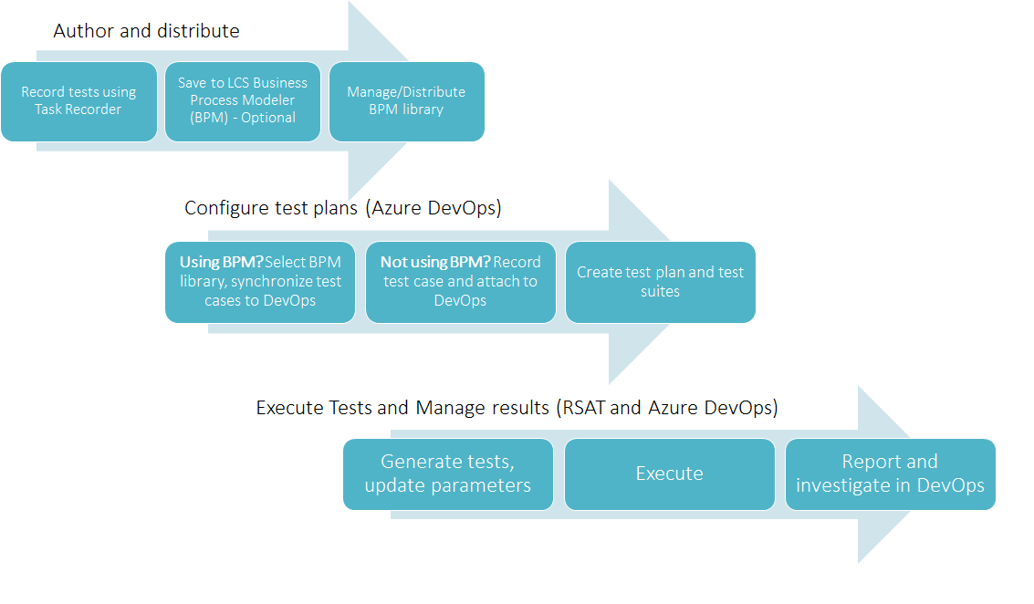

Slide 154
CI/CD Pipeline Security and Compliance
Access Control
Compliance
Secret Management
Azure DevOps provides role-based access control (RBAC) to manage access to pipeline resources, ensuring that only authorized users can perform specific tasks and access sensitive information.
Azure DevOps provides a set of built-in compliance policies and auditing capabilities, as well as the ability to integrate with third-party security tools, to help you meet compliance requirements such as GDPR, HIPAA, and PCI DSS.
Azure DevOps provides secure and encrypted secrets management capabilities, so that sensitive information such as passwords, API keys, and certificates can be securely stored and used in your pipelines without being exposed in the pipeline configuration or code.

Slide 155
CI/CD Pipeline Best Practices
Automate
Test
(Actually) Use CI
Automating your build, test, and deployment processes can help to reduce the risk of human error and speed up the delivery of new code changes.
Use automated testing to validate your code changes as early as possible in the development process. This can help you to catch and fix issues before they become major problems.
Set up a Continuous Integration (CI) process to automatically build and test your code every time new code changes are committed. This can help you to catch issues early and ensure that your code is always in a releasable state.

Slide 156
CI/CD Pipeline Best Practices
(Actually) Use CD
Monitor and Measure
Use Continuous Delivery (CD) to automatically deploy your code changes to production once they have passed all tests. This can help you to reduce the time it takes to get new code changes into UAT and speed up your software delivery process.
Use tools to monitor and measure the performance of your CI/CD pipeline, such as build and test duration, code coverage, and deployment success rate. This can help you to identify bottlenecks and areas for improvement.
Regularly review and evaluate your CI/CD pipeline to identify areas for improvement. Use feedback from your team and customers to continually refine and optimize your CI/CD process.

Slide 157
Activity 8
Have the attendees run a code coverage report and discuss the results.
Notes:
https://www.codecrib.com/2019/02/repost-enabling-x-code-coverage-in.html

Slide 158
Activity 9
Have the attendees practice setting up automated testing with Atl or other testing tools.

Slide 159
Activity 10
Have the attendees practice setting up code validation in a build pipeline.

Slide 160
Release Pipelines

Slide 161

Overview
Devs can deploy their applications to multiple environments
Upload deployable package to LCS then deploy a non-production environment
Typically either Gold, Data Migration, or UAT for F&O

Slide 162

Notes:
https://ariste.info/en/2019/10/devops-alm-automation-in-microsoft-dynamics-365-for-finance-and-operations/

Slide 163
Continuous Delivery Suggestions
Automate as much as possible.
This can be set to run on a schedule with an approval workflow so code can just automatically be deployed to environments for review, extended testing, whatever that environment is used for.
Use Schedules to deploy code while you’re sleeping
Use the approval workflow so if something bad is released, you didn’t approve.

Slide 164
DevOps Extensions that are useful
VM Management
F&O Tools
Turn a VM on (or off) in a pipeline
Dynamics 365 Finance and Operations Tools – Required
D365FO.Tools – Highly suggested

Slide 165
DevOps Extensions that are useful
Pipelines
Azure DevOps
Use Pipeline Triggers
Chain pipelines together
Trigger pipelines from events like a commit or PR
Pull Request Merge Conflict Extension
Allows for some light-weight merge conflict resolution online, typically during a PR

Slide 166
DevOps Extensions that are useful
Release Notes
Teams Integration
Generate Release Notes Extension
Azure Pipelines for Microsoft Teams

Slide 167
Automating Testing with DevOps

Slide 168
Activity

Slide 169

X++ Package Management A Discussion
Should you have 1 (Custom) Package in a Repo?
Multiple Packages?
What about “Friend” Packages?
And ISVs?
What is “Best Practice” for this?
1 Model per customization?
1 Model per package?

Slide 170
Lastly
Any X++ tips or tricks you want to share?

Slide 171
Using C#
You Can Use C# in X++
Add it to your solution
Can use LINQ to interact with F&O Data in C#
Add Reference in F&O to C# Project
Set Build Order on Solution
Outputs .dll into PackagesLocalDirectory folder to be used
Notes:
https://learn.microsoft.com/en-us/dynamics365/fin-ops-core/dev-itpro/dev-tools/write-business-logic
https://ariste.info/en/dynamics365almguide/add-a-c-project-to-fno/
https://ariste.info/en/dynamics365almguide/build-pipeline/

Slide 172
Q&A

Slide 173
Wrap up
Source Control
Build Pipelines
Release Pipelines
Package Management
Testing, Automation, and X++

Slide 174


Contact
nclouse@envistacopr.com
Twitter: @NathanClouseAX
https://www.linkedin.com/in/nathanclouseax/
www.atomicax.com
www.dynamics.fo

